Slide 1
TRASHING FOOD WASTE WITH TECHNOLOGY
presents
Post Activity
Proudly supported by
www.aitc-canada.ca

Slide 2
What is Food Security
“food security exists when all people, at all times, have physical, social and economic access to sufficient, safe and nutritious food which meets their dietary needs and food preferences for an active and healthy life.”
The Food and Agriculture Organization of the United Nations

Slide 3
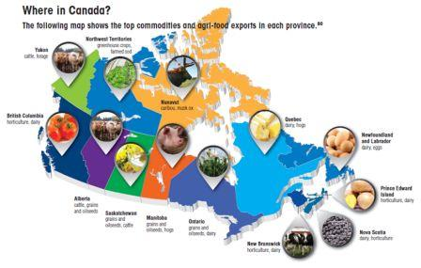
Notes:
Show commodity map of what is grown across Canada and comment on what they grow and why. How does the geographic region contribute to what grows where? Do you think Canadian’s diets differ based on what is grown around us – is the Ontario diet different from a diet of someone in BC or Newfoundland? Why or Why not? What types of things do we do to ensure we have food available to us all year round?

Slide 4
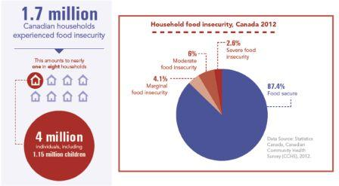
Food Insecurity in Canada
Source: Sharon Kirkpatrick, School of Public Health and Health Systems University of Waterloo http://www.opened.uoguelph.ca/foodsecurity/PPT_SKirkpatrick.pdf
Notes:
Ask: Do Canadian’s experience food insecurity? YES
• Show the students the info stats of Canadian households experiencing food insecurity (1.7 million Canadian households experience food insecurity).

Slide 5
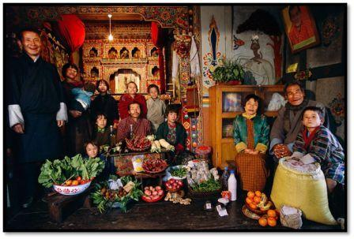
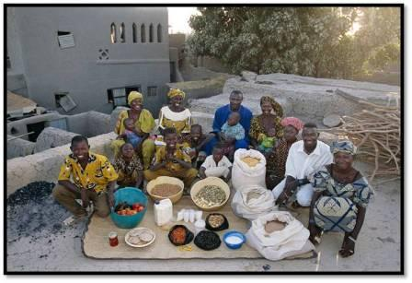
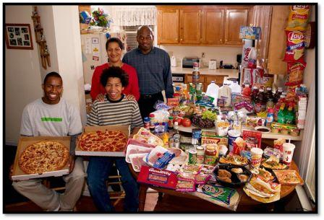
What the World Eats
http://time.com/8515/hungry-planet-what-the-world-eats/
Notes:
Explore the images from the photo documentary called “What the World Eats” by Peter Menzel and Faith D’Aluision (http://time.com/8515/hungry-planet-what-the-world-eats/). Ask students to comment on the following:
What do they notice about the amount of food eaten around the world? How do countries like the United States and Mali compare (note amounts of food and the number of people in the family).
Have students comment on the types of foods that are being eaten. Are the foods processed? Is their diet protein based? How does the geography impact what they are eating (fish diets in coastal regions, citrus diets in warmer regions).
Look at the captions and comment on the amount of money each family spends on their food. How does it compare to other countries.
How does culture impact food choices? How does geography impact culture?

Slide 6
The Faces of Farming
National Geographichttp://www.nationalgeographic.com/foodfeatures/feeding-9-billion/
Notes:
Next, explore the National Geographic website, “A Five Step Plan to Feeding the World” (http://www.nationalgeographic.com/foodfeatures/feeding-9-billion/) and look at the heading “Faces of Farming”, and as a class examine the 16 pictures and captions of the farmers throughout the world. Make connections between the photos seen here and the ones from What the World Eats.
What similarities exist between the farmers and families from similar regions? How are the families diets connected to what the famers are growing?
Again, how does geography impact what the farmers from around the world are growing?
Do the pictures allude to what technologies are being used? What technologies do you think are being used on each farm? Why?

Slide 7
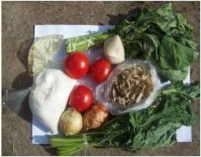
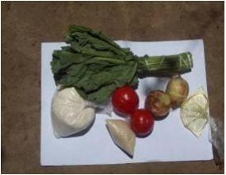
What a dollar can buy in Zambia
February 2008
February 2009
Source: Accounts of Crisis: Poor People's Experiences of the Food, Fuel and Financial Crisis in Five Countries. March 31, 2009 https://www.ids.ac.uk/files/dmfile/AccountsofCrisisFINAL.pdf
Notes:
This is a photo of what 5 000 Kwacha (about a dollar Canadian) can buy in Zambia. Notice the difference one year later. Especially the lack of protein the second picture. This is due to a spike in food prices, which leads to rioting and revolutions

Slide 8
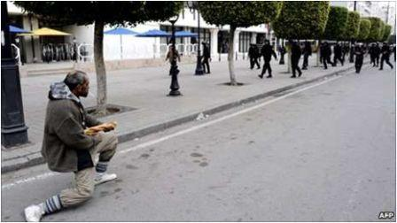
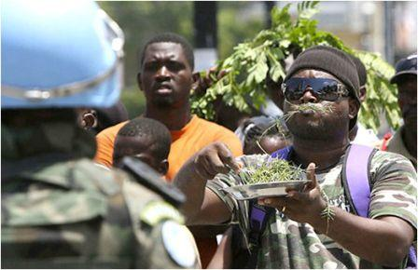
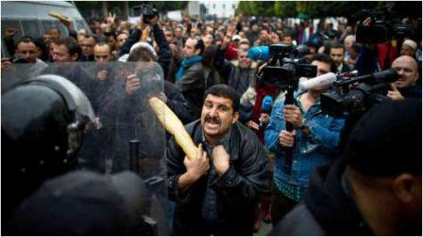
Food Insecurity – Political Unrest
http://crisisboom.com/2011/01/12/the-future-of-food-riots/
http://media.npr.org/assets/img/2012/10/01/food_riot_wide-5ac93fb3df821987c05abd26a3b12660caf0d588-s6-c30.jpg
http://global3.memecdn.com/Have-you-ever-been-so-angry_o_70452.jpg
Notes:
Riots, revolutions and unrest start with the cost of food prices. Picture top left is from Tunisia, the picture on the bottom left is from Egypt and bottom right is from Haiti , notice how the food plays a key role in political unrest and rioting.

Slide 9
Food Insecurity
Today, the world population is just over 7 billion people
It is estimated that by 2050 the world population will reach 9 billion
-Question: HOW WILL WE FEED NINE BILLION? -
Notes:
B

Slide 10
Farm Food 360
http://www.farmfood360.ca/

